Slide 1
Web Fundamentals Chekpoint Project
Abderrahman Dhahak

Slide 2
How does the web works?
Web servers and web browsers communicate via HTTP
HTTP ensures that all parts of the web page are delivered
Web browser decides how these items are displayed
(HTTP : Hypertext Transfer Protocol)

Slide 3
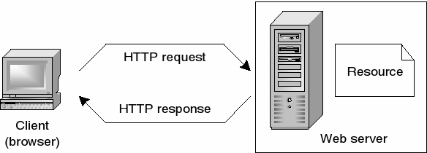
Figure 1 : How HTTP works: retrieving a web page

Slide 4
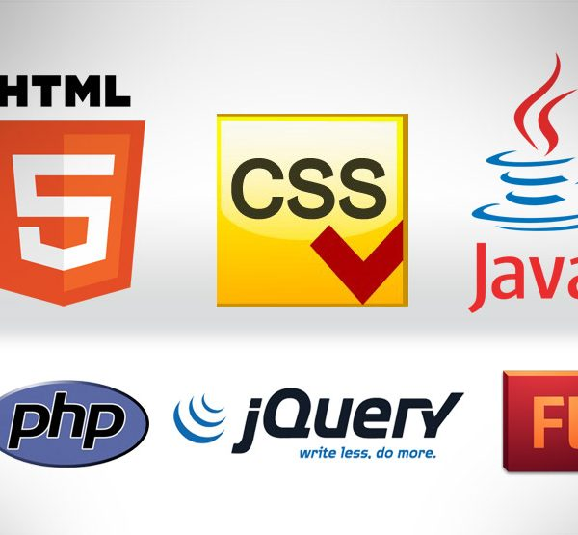
What do you need to be a web developer?
Coding languages including HTML and CSS
Frontend web programming languages and skills such as JavaScript, Ajax and web animation techniques
Backend web programming languages such as C# or Java, PHP and Ruby
Figure2: Different coding languages

Slide 5
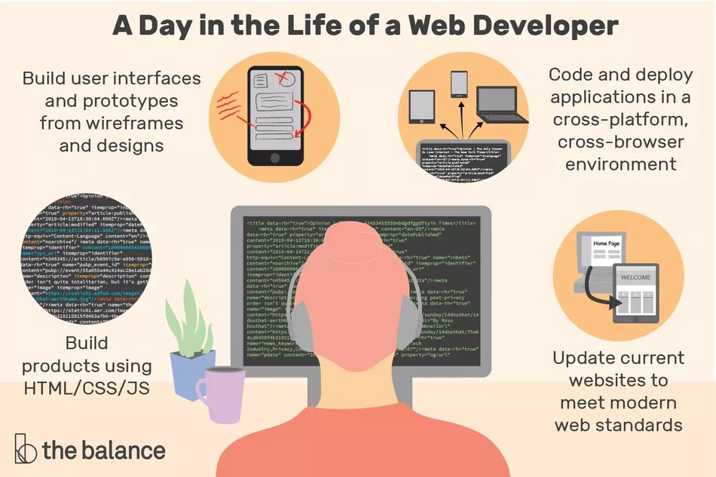
What’s the role of a web developer.
Build user interfaces and prototypes from wireframes and designs
Code and deploy applications
Build products using HTML/CSS/JS
Update current websites to meet modern web standards
Figure 3: A day in the life of a web Developer

